Slide 1

MBA – Sem 4 – FINANL PROJECT
Predicting Ad Accessibility And Engagement On Social Media Platforms Using Statistical & Business Intelligence Tools
Project Title
Student Name & Roll Number
UMAMAHESWARI R & EA2352001010040
Course & Semester
MBA – Business Analytics & Semester IV
Dr.K.D.Balaji (Assistant Professor)
Guide Name
Institution Name
SRM Institute of Technology – Directorate of Online Education, Chennai
Date of Viva
24-MAY-2025

Slide 2


Synopsis
Research Background
Social media is central to modern digital marketing.
Businesses use data-driven strategies for ad optimization.
BI and statistical tools enhance ad targeting and campaign performance.
Predictive analytics helps understand user behaviour and engagement, & Platforms like Google Analytics, Power BI, and IBM Watson are widely used.
Research Objective
To analyze social media ad accessibility and engagement.
Optimize digital strategies for technical education platforms.
Enhance campaign ROI using predictive and BI tools.
Understand user response through real-time data tracking.
Methodology
Expected Outcomes
Significance
Descriptive research design with quantitative data.
Survey of 61 respondents aged 18–45.
Use of tools like Google Analytics, Power BI, Tableau, Watson, Big Query, and Python.
Statistical techniques: Chi-square, correlation, and percentage analysis.
Identify high-engagement ad types and formats.
Segment users based on demographics and interaction.
Recommend effective targeting strategies.
Improve ad relevance and personalization.
Bridges gap between traditional ads and data-driven marketing.
Assists EdTech firms in fine-tuning social media strategies.
Enhances ROI through optimized budget allocation.
Builds trust with targeted, relevant content delivery.

Slide 3
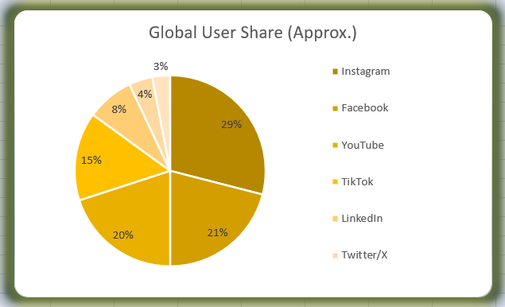
Introduction
Industry Size
Top Industry Players
Influencing Factors
Online education is a multi-billion-dollar industry. 50 %+ of global digital ad spending is on social media. Education and training are top ad sectors.
User interests and behavior.
Demographic Factors (age, gender).
Visual appeal, discounts, and influencer recommendations.
Platform-specific content preferences.
Global Market
Global EdTech ad budgets are rapidly increasing.
AI and data tools are transforming ad personalization.
Platforms like Instagram and Facebook dominate globally.
Indian Market
Key Trends
Key Challenges
India has one of the fastest-growing online education sectors.
AI-driven ad targeting
Ad fatigue and user skepticism.
Privacy concerns and data tracking limitations.
Relevance vs. intrusion balance.
Measuring ROI effectively.
Sentiment and engagement tracking via BI tools.
EdTech platforms extensively use digital ads for outreach.
Instagram and YouTube are key ad channels for younger users.
Interactive and video content is preferred.
Personalization and automation are gaining momentum.

Slide 4
Introduction & Background
Study Context
Focused on technical training organizations.
Evaluates student engagement through digital platforms.
Enhances student acquisition through targeted ads.
Industry Significance
Customer retention crucial for revenue growth and competitiveness
High competition among EdTech players.
Data analytics is essential for precision targeting.
Research Gap
Limited research on predictive advertising in EdTech.
Scarcity of studies combining BI tools and statistical models.
Need for integrated digital ad optimization frameworks.

Slide 5
Objective of Study
Primary Objectives
Predict ad engagement and accessibility using data tools.
Improve ad targeting effectiveness.
Maximize ROI for social media campaigns.
Secondary Objectives
Compare ad strategies across platforms.
Evaluate the effectiveness of visual, video, and interactive ads.
Explore user motivations for ad interaction.
Recommend optimization techniques.

Slide 6
Research Problem & Statement
Research Questions: "What We're Investigating
What factors influence ad engagement on social media?
Which platforms and formats are most effective?
How do demographics affect ad responses?
Study Implications: "The Impact"
Provides actionable insights for marketers.
Helps align content with user expectations.
Drives efficient ad budgeting and creative planning.
Target Beneficiaries: "Who Will Benefit"
EdTech companies and digital marketers.
Marketing strategists and analysts.
Policy makers in digital education.

Slide 7
Scope of Study
Study Coverage: "What We'll Examine"
Technical training providers on social platforms.
Focus on Facebook, Instagram, LinkedIn, and Twitter.
Audience aged 18–45.
Study Boundaries: "The Limits"
Limited to 61 survey responses.
Specific to education-based ad campaigns.
Does not cover entertainment, e-commerce ads.
Key Dimensions: "The Focus"
Engagement frequency, platform preference, ad type.
Demographics: age, gender, education.
Perceived ad relevance and user actions.

Slide 8
Methodology
Research Type: "Quantitative Analysis"
Descriptive and Quantitative.
Uses survey and content analysis.
Sampling Technique & Size: "Data Selection"
Non-probability sampling.
Sample size: 61 social media users.
Data Collection Methods: "Data Sources"
Structured online questionnaire.
Platforms analyzed: Facebook, Instagram, LinkedIn, Twitter.
Statistical Analysis Tools: "Data Analysis"
Tableau, Big Query, Power BI, IBM Watson, Python.
Chi-square test, Pearson correlation, percentage analysis.

Slide 9
Analysis & Findings
Demographic Insights
Majority aged 18–35; females dominate the sample.
Instagram is the most-used platform.
Users spend 1–3 hours on social media daily.
Category Insights
Video ads are the most engaging (59%).
Engagement mostly driven by interest relevance.
Users often save or ignore ads after seeing them.
Additional Insights
62% feel ads are mostly relevant.
Preference for engaging visuals, customer reviews.
Users show concern about data privacy and tracking.

Slide 10
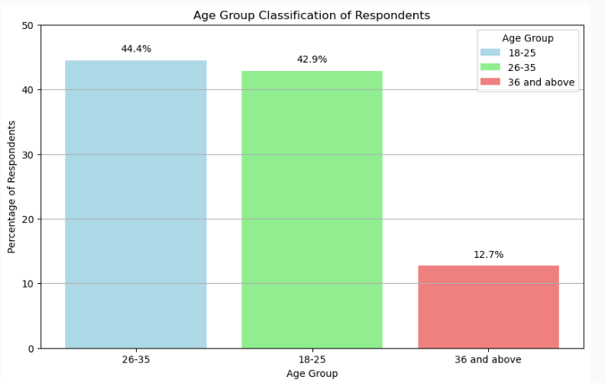
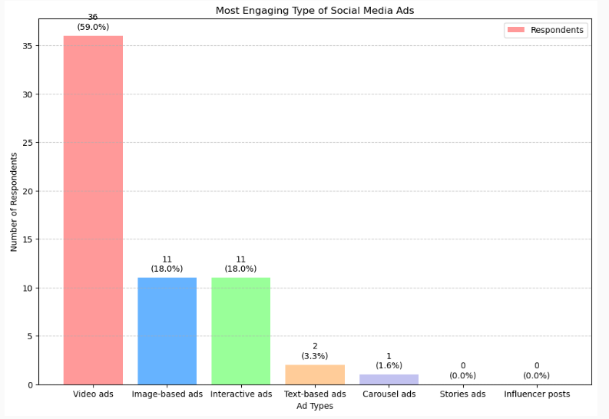
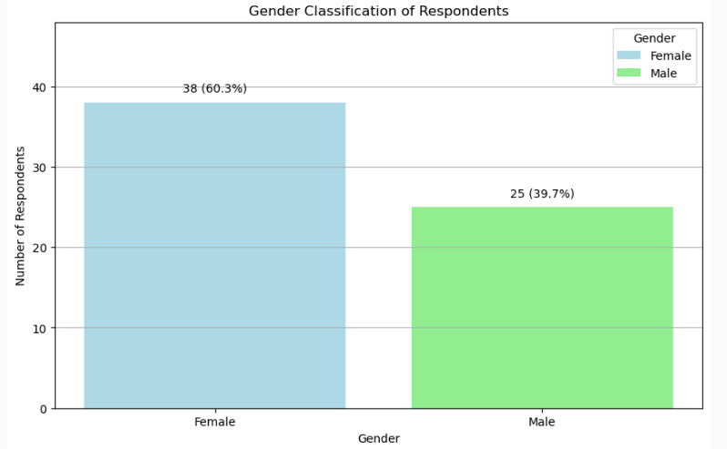
Analysis & Findings
Data Analysis Charts (Tableau)

Slide 11
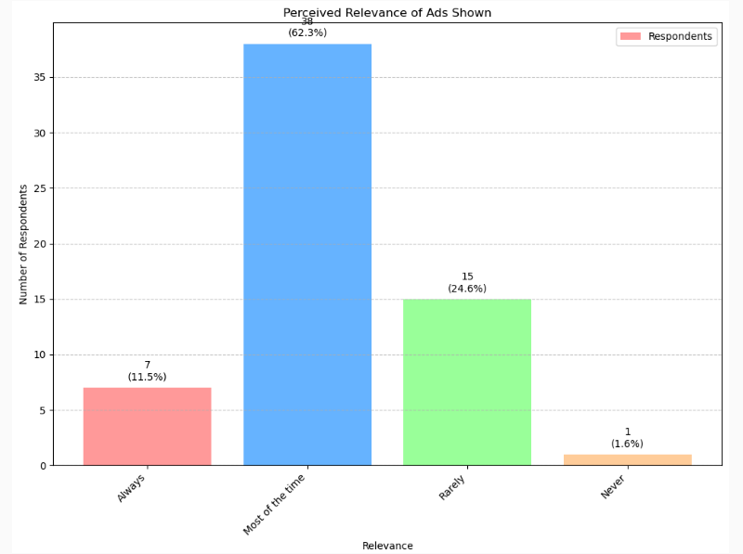
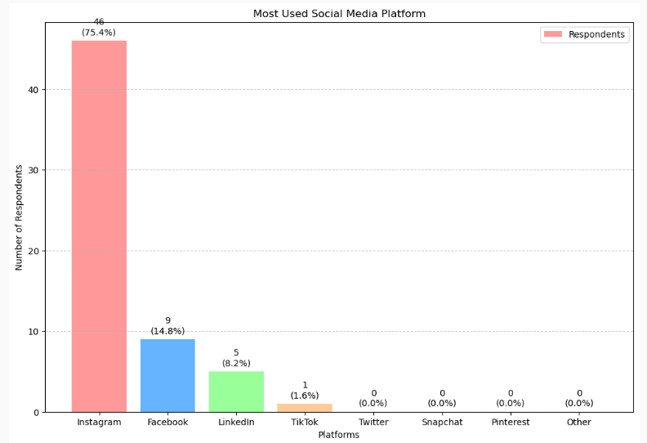
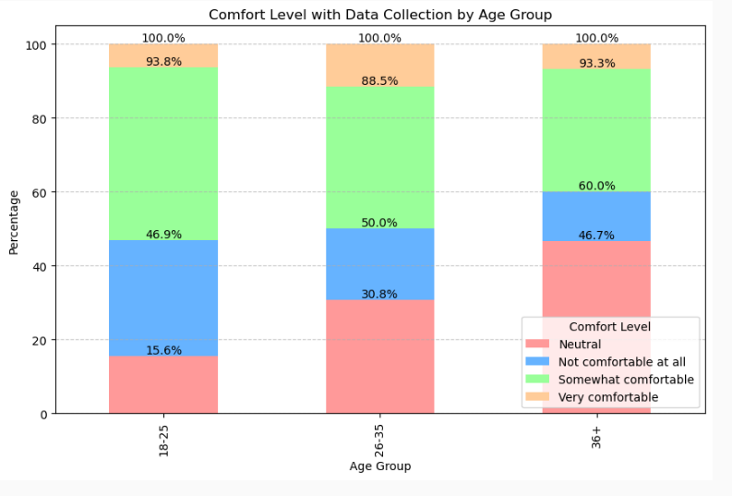
Analysis & Findings
Data Analysis Charts (Tableau)

Slide 12
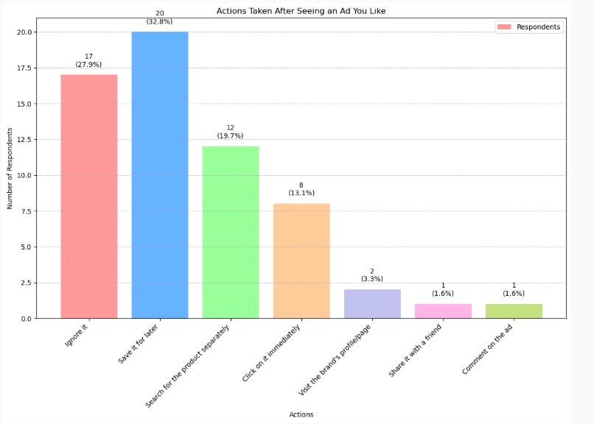
Analysis & Findings
Key Visual Insights (Tableau)

Slide 13
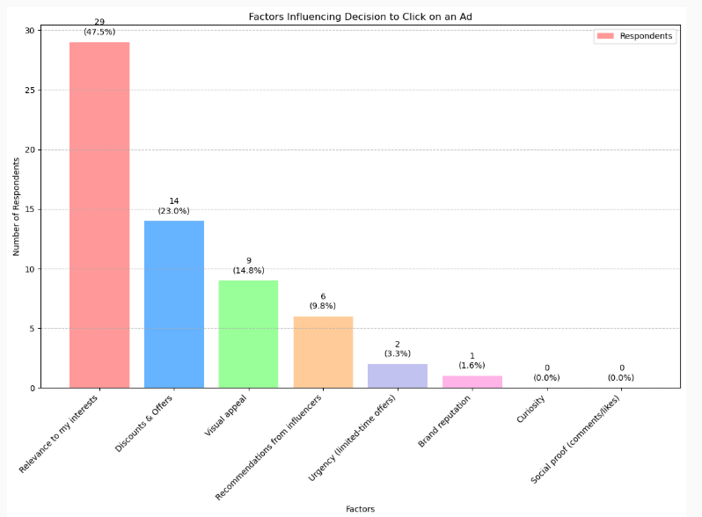
Analysis & Findings
Key Visual Insights (Tableau)

Slide 14
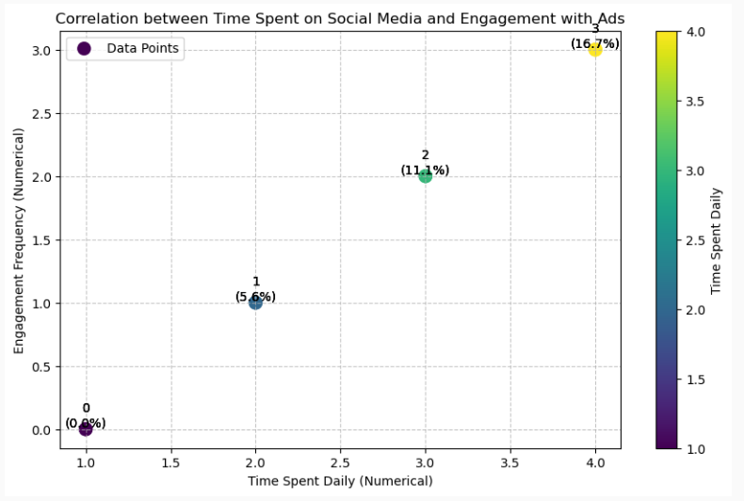
Analysis & Findings
Key Visual Insights (Tableau)

Slide 15
Analysis & Findings
Key Visual Insights (using Google BigQuery )
Age Group | Platform | Revisit Reason | Responses
18-24 | Instagram | Discount or Promo Code | 22
Predict Return Visits
Age Group | Gender | Platform | Ad Type | Converted | Total | Conversion Rate (%)
18-24 | Female | Instagram | Fashion | 12 | 15 | 80.00%
Estimate Conversion Rate

Slide 16
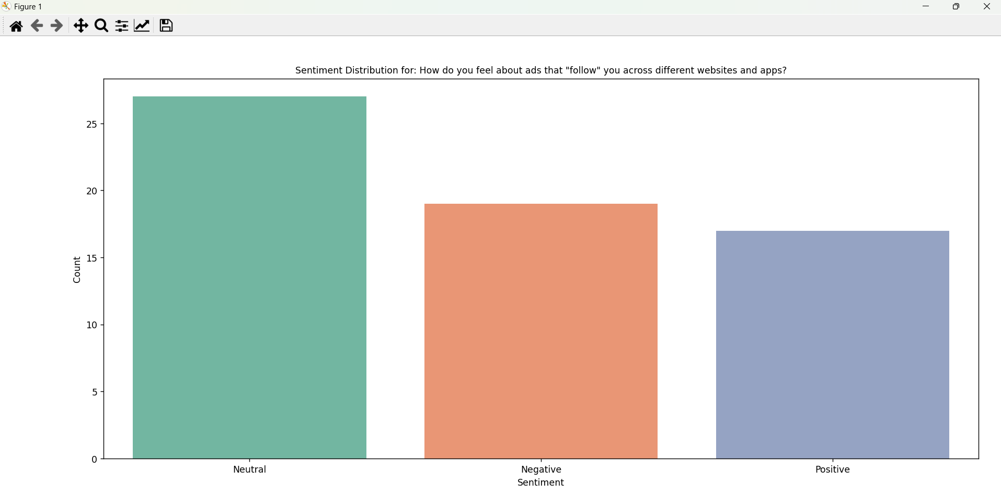
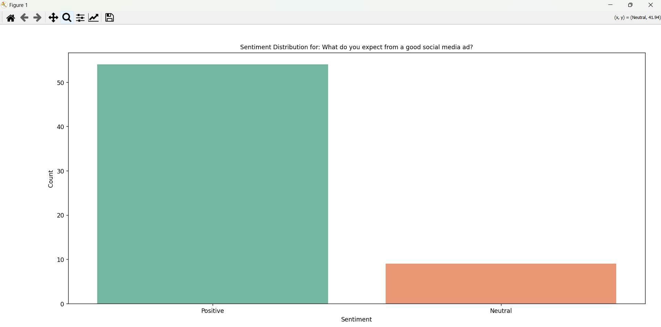
Analysis & Findings
Key Visual Insights (using Python )

Slide 17
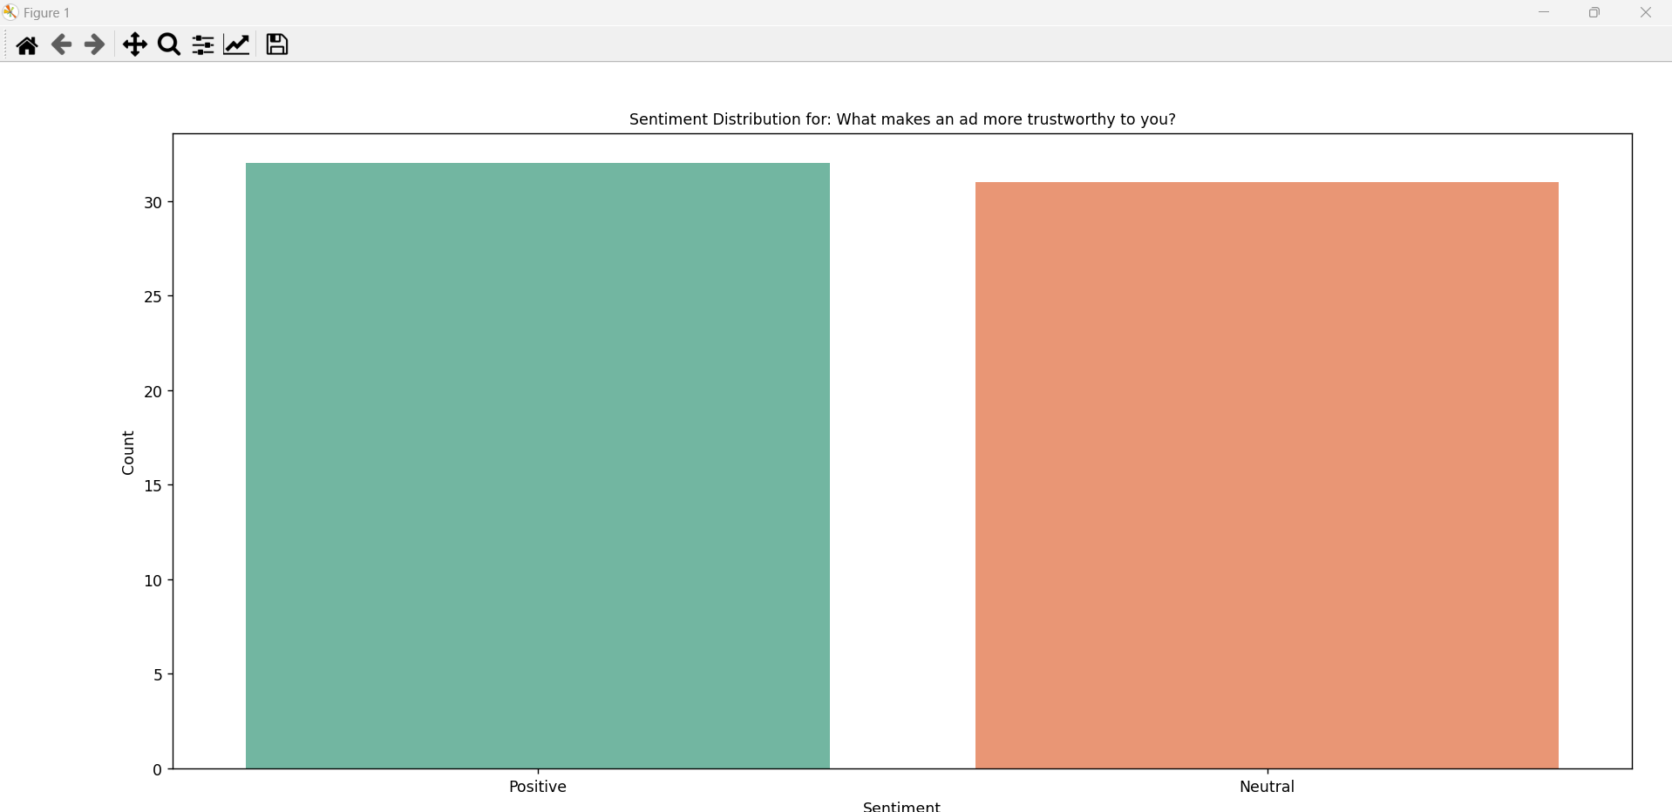
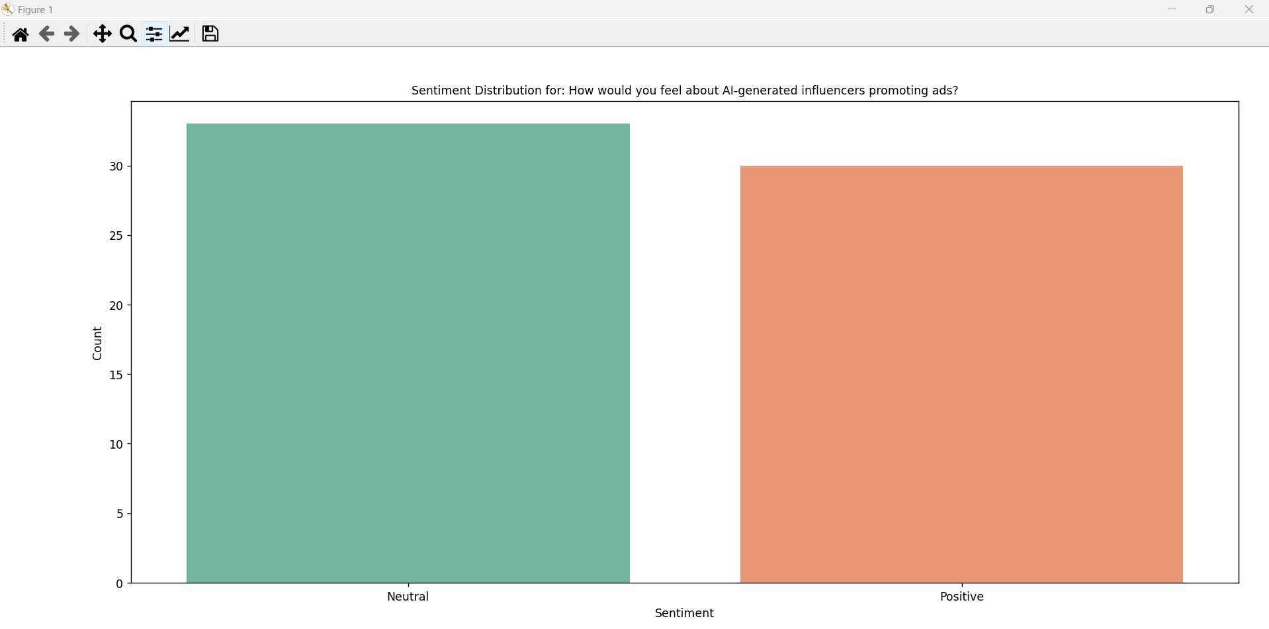
Analysis & Findings
Key Visual Insights (using Python )

Slide 18
Interpretation & Discussion
Insights and Implications: What the Findings Mean
Personalization drives engagement.
Video and interactive ads yield higher ROI.
Data tools can predict effective content formats.
Achieving Customer Retention: (Meeting Objective)
Focus on long-term trust via transparency.
Use ad retargeting and remarketing strategies.
Build recall for delayed purchase behavior.

Slide 19
Conclusion
Key Findings and Implications
Video ads and platform-specific content work best.
BI tools are essential for targeting and campaign refinement.
Trust and personalization influence engagement.
Achieving Study Objectives
Data analytics successfully predicted user behavior.
Engagement patterns mapped through statistical insights.
Strategic ad improvements were suggested based on findings.

Slide 20
Recommendations
Improvement Suggestions
Use more interactive ad formats.
Address user privacy concerns openly.
Future Direction Suggestions
Expand the study with a larger, diverse sample.
Explore AI-generated content impact further.
Strategic Recommendations
Shift budget toward high-engagement platforms (e.g., Instagram).
Implement sentiment tracking dashboards in real-time.
Operational Recommendations
Use A/B testing for ad performance.
Monitor ad fatigue and refresh creative assets regularly.
Policy Recommendations
Maintain transparency in data collection practices.
Encourage ethical AI use in influencer marketing.

Slide 21
Limitations
Limitations and Implementation Challenges
Limited sample size (pilot study level).
Participant bias and self-reported data limitations.
Generalizability restricted to similar demographic.
Survey method dependent on digital literacy.
Does not include longitudinal ad performance analysis.

Slide 22
References
Books
“Digital Marketing: Strategy, Implementation and Practice” – Chaffey & Ellis-Chadwick
“Discovering Statistics Using IBM SPSS” – Andy Field
Websites
Google Analytics Help
Tableau Documentation
Statista – Social Media Advertising
Journals
Psychology & Marketing
MIS Quarterly
Computers in Human Behavior
Thesis
SRM Institute-approved MBA thesis document.

Slide 23

THANK
YOU

